Slide 1


Churn Analysis Using MySQL and Power BI

Slide 2

Introduction
Project Overview: Analyzing customer churn to understand patterns and reduce churn rate.
Objectives: Identify key metrics, analyze customer behavior, and provide actionable insights.
Data Sources & Tools
Data Source: Customer Churn Dataset
Tools: MySQL for querying data, Power BI for visualization

Slide 3

Problem Statements
Identify the total number of customers and the churn rate
Churn Rate 32.80 %

Slide 4

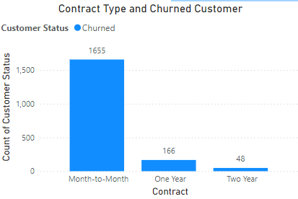
Find the average age of churned customers
Discover the most common contract types among churned customers

Slide 5


Analyze the distribution of monthly charges among churned customers

Slide 6

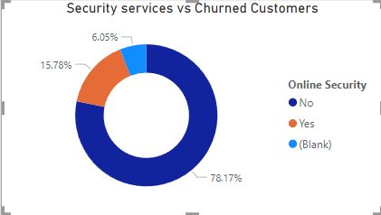
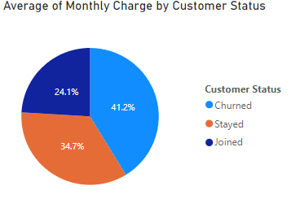
Identify customers who have both online security and online backup services and have not churned
Calculate the average monthly charges for different contract types among churned customers

Slide 7
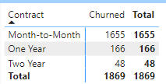
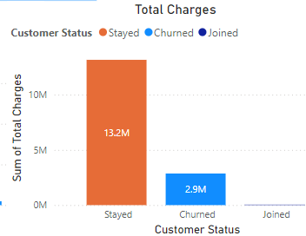
Create a query to identify the contract types that are most prone to churn
Calculate the total charges distribution for churned and non-churned customers

Slide 8
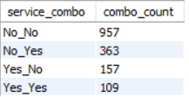
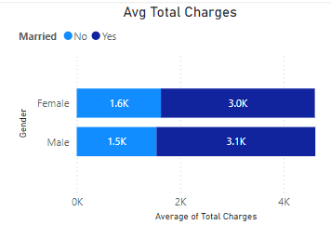
Determine the most common combinations of services among churned customers
Identify the average total charges for customers grouped by gender and marital status

Slide 9
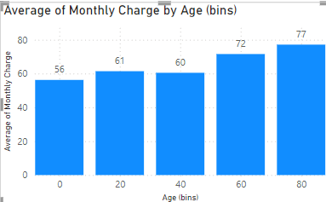
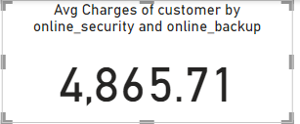
Calculate the average monthly charges for different age groups among churned customers
Determine the average age and total charges for customers with multiple lines and online backup

Slide 10
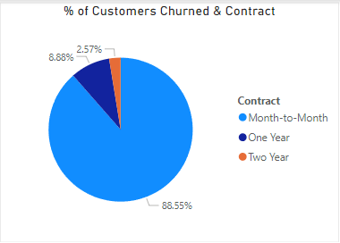
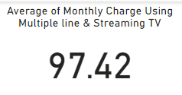
Identify the contract types with the highest churn rate among senior citizens (age 65 and over)
Calculate the average monthly charges for customers who have multiple lines and streaming TV

Slide 11
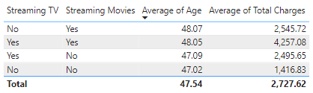
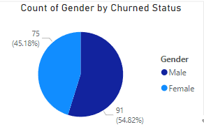
Calculate the average age and total charges for customers with different combinations of streaming services
Identify the gender distribution among customers who have churned and are on yearly contracts

Slide 12
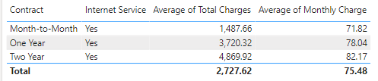

Calculate the average monthly charges and total charges for customers who have churned, grouped by contract type and internet service type
Find the customers who have churned and are not using online services, and their average total charges

Slide 13

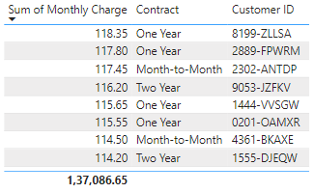


Calculate the average monthly charges and total charges for customers who have churned, grouped by the number of dependents
Create a view to find the customers with the highest monthly charges in each contract type

Slide 14
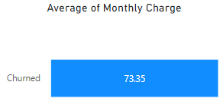

Create a view to identify customers who have churned and the average monthly charges compared to the overall average
Create a view to find the customers who have churned and their cumulative total charges over time

Slide 15

THANK YOU
Any Questions

